Slide 1
Augmented Reality for Infrastructure Mapping
Presented by: FYP-24-SE-A-04
Supervisor: Sir Zahid Javed

Slide 2
Table of Contents
Problem Statement
Proposed Solution
Key Features
Technology Stack
Expected Outcomes
Conclusion

Slide 3
1. Problem Statement
Inefficiencies in visualizing building systems such as wiring and piping.
Hidden systems behind walls lead to costly exploratory work.
2D plans do not provide accurate spatial understanding.
Absence of a mechanism to overlay 3D models on the real world.

Slide 4
2. Proposed Solution
Use AR to overlay 3D models onto the physical environment.
QR codes to anchor models in precise locations.
Technicians can visualize systems in real-time, accurately aligned with the real
environment.

Slide 5
3. Key Features
Real-Time 3D Visualization: Seamless overlay of 3D models onto real-world environments.
Accurate System Alignment: QR codes ensure accurate positioning of infrastructure models.
Mobile Accessibility: Engineers and technicians can access infrastructure details on-site.
User Interaction: Ability to zoom, rotate, and interact with 3D models for detailed inspection.

Slide 6
4. Technology Stack
SketchUp: For 3D model creation and export.
ARCore: For AR functionalities like motion tracking and depth sensing.
QR Code Libraries (ZXing/Google Vision): To anchor models accurately.
Flutter/React/Next.js: For the mobile app interface.

Slide 7
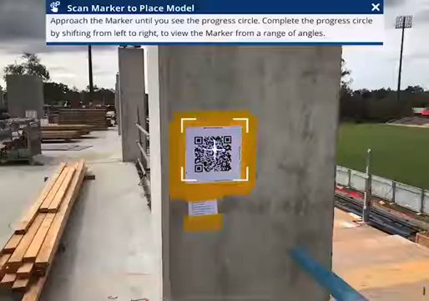

Slide 8
5. Expected Outcomes
Enhanced accuracy in locating and visualizing infrastructure systems.
Reduced errors, delays, and rework due to accurate spatial understanding.
Increased efficiency and time savings for engineers and technicians.
Cost-effective construction and maintenance processes.

Slide 9
6. Conclusion
AR application solves existing infrastructure visualization challenges.
Accurate, real-time 3D models ensure efficient maintenance and construction.
Optimized for mobile use with QR codes ensuring precise model alignment.

